Slide 1

Wits Software Development 2016 Mathematical Sciences Support Group Session 2
By Jason Chalom

Slide 2
Development Strategies
There are general strategies which have defined academic definitions
These are used as a guideline for how a project should be structured
Command structure
Work structure
Documentation
Testing
Implementation
There is also the high level development strategy set out to achieve the objectives of the project

Slide 3
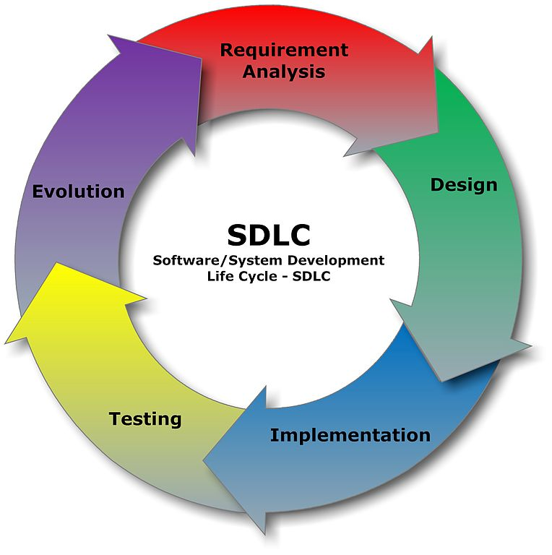
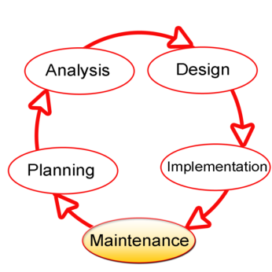
Software Development Life Cycle (SDLC)
The process of producing an information system
Also known as the software development process
Dividing the process of making software into distinct phases or parts
Different models or divisions refer to different development methodologies
The oldest monolithic methodology
Very Rigid
https://en.wikipedia.org/wiki/Systems_development_life_cycle

Slide 4
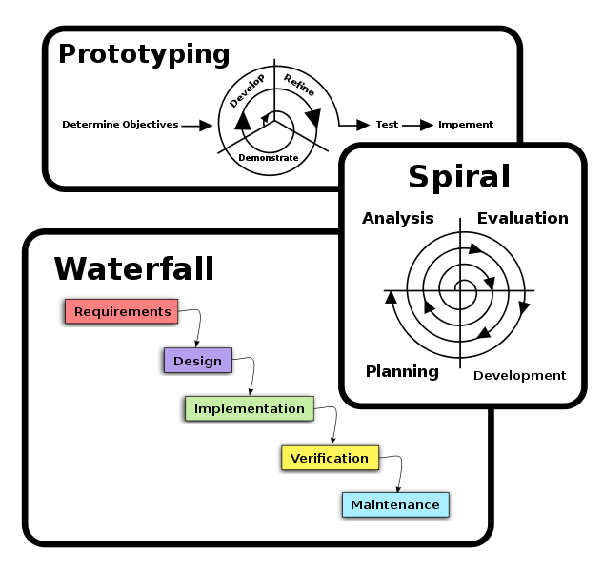
Classical
There are many different methodologies and variations of methodologies, we will only cover a few
The “classical” or traditional approaches tend to have more distinct phases
SDLC directly refers to these approaches, life cycle approaches come later on.
These distinct phases were considered to occur as their own individual units and also not concurrently.

Slide 5
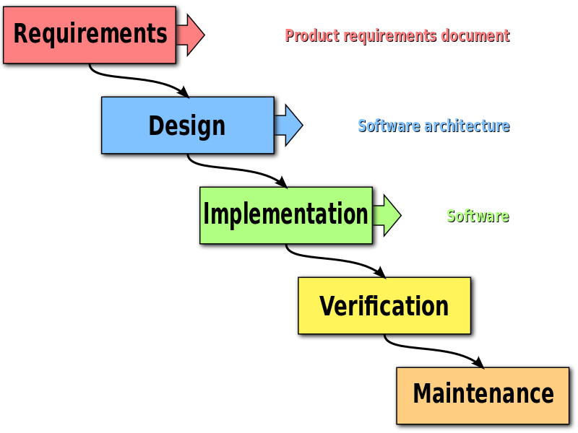
Waterfall Model
Most “classic” of the models
Each phase falls after the other
Several other models follow similar processes
Sequential and flows downwards
Method:
Project is divided up into phases
Some versions allow some overlap in the phases
Emphasis on planning, resources, targets and implementation
Tight control – lots of documentation

Slide 6
Waterfall Model
Some Advantages
Testing is enforced at every stage
Documentation at every phase and decision
Some Disadvantages:
Costly
Takes lots of time to implement – overhead
Flaws in early design trickle down
A lot of overlap between phases where the same work has to be done several times
i.e. When planning a database the models used there are done in different forms later on
Not very flexible
Not Client friendly

Slide 7
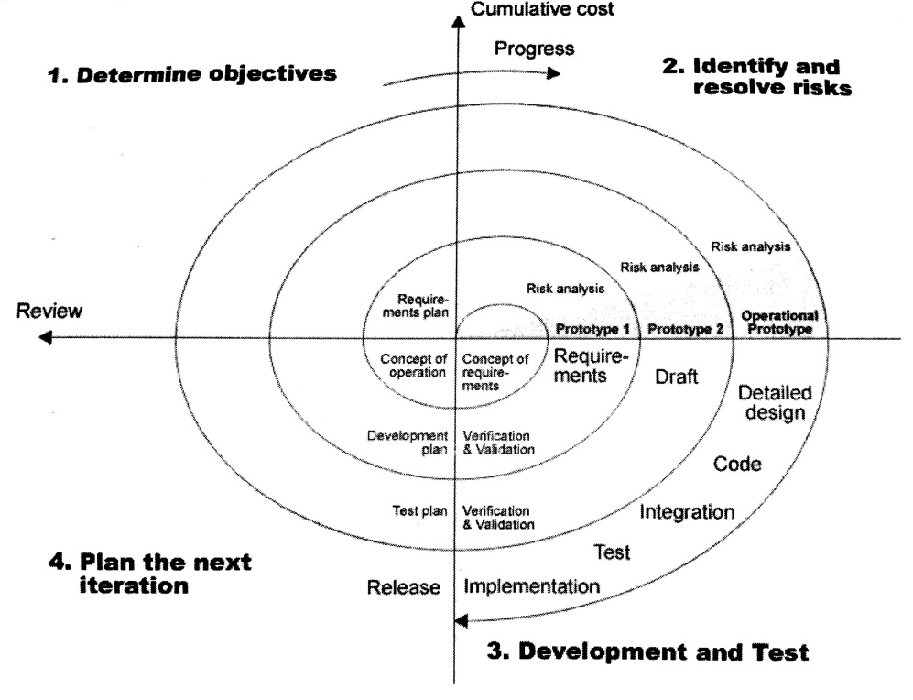
Circular Model
AKA The Spiral Model
Various parts of the system given to the client at different times
Has to be planned methodically, with tasks, prerequisites and products for each step of the spiral

Slide 8
Circular Model
Advantages
More realistic estimates
Change is handled better
Implementation is earlier
Implies less resource strain
Disadvantages
Can be costly
Can take longer
Small projects don’t fit this model particularly well

Slide 9
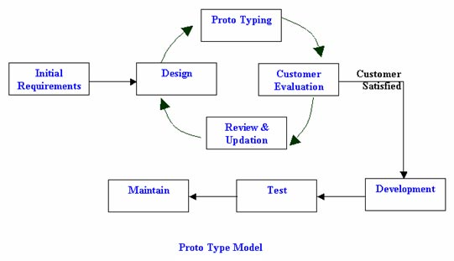
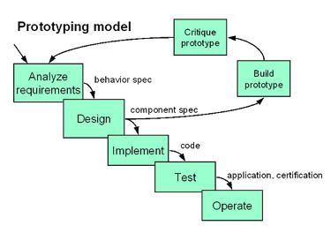
Prototyping
A model which tries to combine aspects from other models
Allow users of the software and also the client evaluate proposals for an eventual design
Not a monolithic development cycle
Attempts to reduce inherent project risk
Iterative modification
Identify basic requirements (i.e. business rules)
Develop initial Prototype
Review
Revise and Enhance the Prototype

Slide 10
Agile Approach
Much more modern set of methodologies
Evolving solutions
Collaboration of smaller cross-functional teams
Adaptive planning
Evolutionary development
Early delivery
Flexibility (rapid response to change)
Continuous improvement

Slide 11
Agile Approach
The Agile Manifesto is based on 12 principles:
Customer satisfaction by early and continuous delivery of useful software
Welcome changing requirements, even late in development
Working software is delivered frequently (weeks rather than months)
Close, daily cooperation between business people and developers
Projects are built around motivated individuals, who should be trusted
Face-to-face conversation is the best form of communication (co-location)
Working software is the principal measure of progress
Sustainable development, able to maintain a constant pace
Continuous attention to technical excellence and good design
Simplicity—the art of maximizing the amount of work not done—is essential
Self-organizing teams
Regular adaptation to changing circumstance
https://en.wikipedia.org/wiki/Agile_software_development

Slide 12
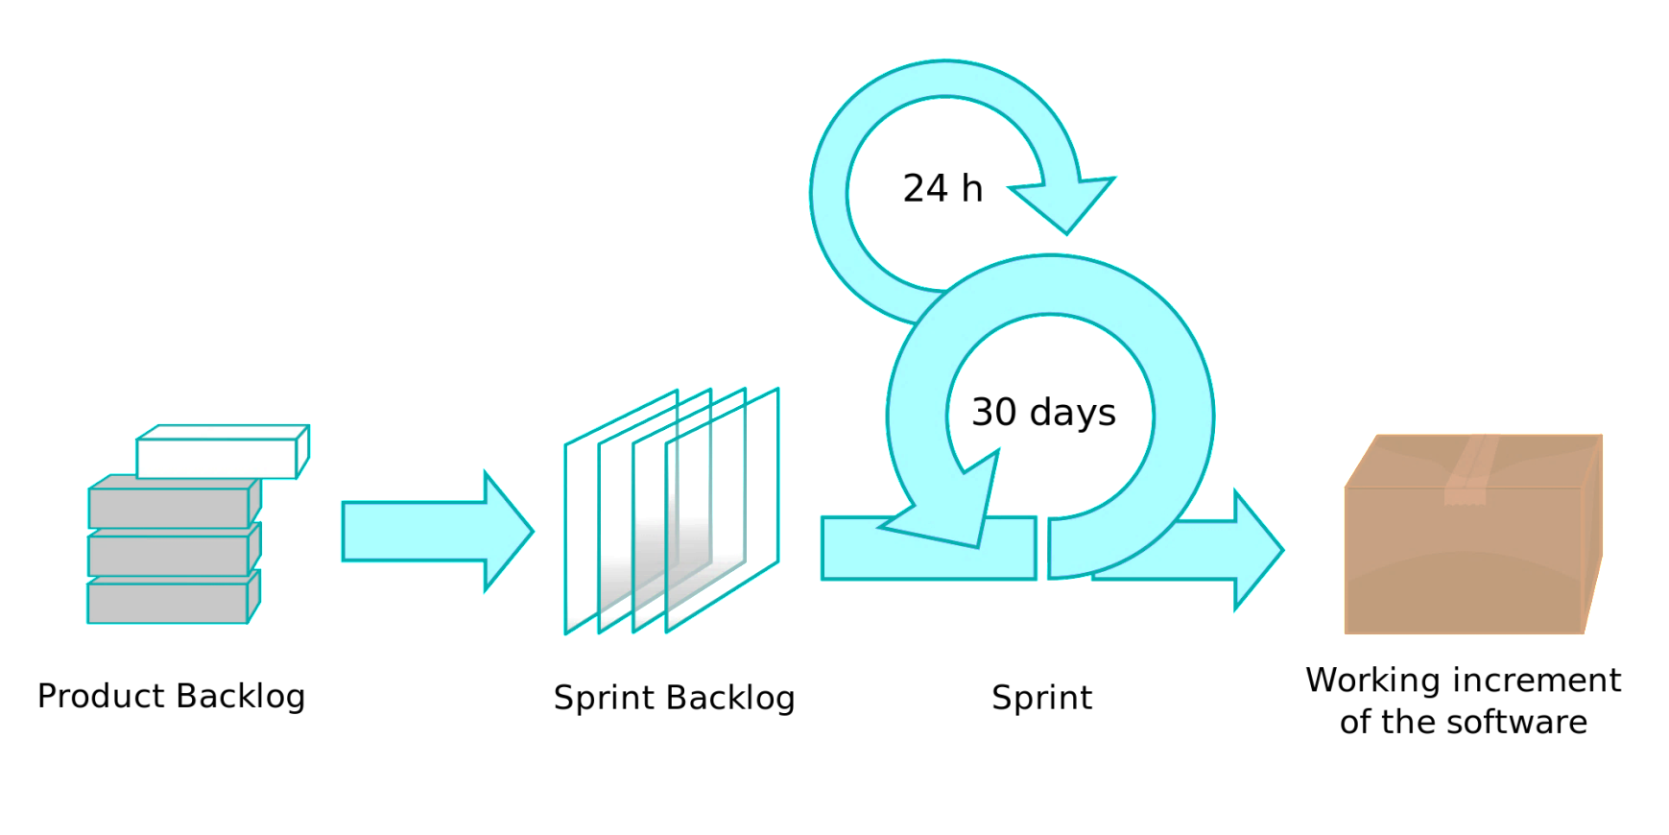
SCRUM
“Scrum emphasizes empirical feedback, team self management, and striving to build properly tested product increments within short iterations.” - http://agilemethodology.org/

Slide 13
SCRUM
Simplest AGILE Approach
Iterative method
Three Team Roles
Scrum Master
Team Member
Product Owner
Recognise that the customer can change their mind mid-way through the project
Accept that the project cannot be fully understood or defined
Respond to a changing problem environment
Must deliver quickly

Slide 14
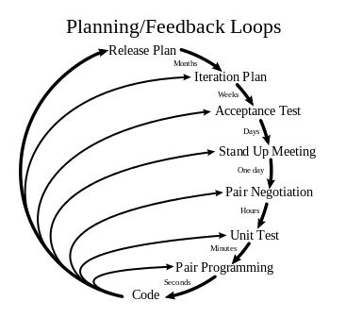
Extreme Programming
Windows XP = Extreme Programming
Improve software quality
Frequent development releases
Short development cycles
Improve productivity
Checkpoints where new requirements can be adopted
90’s era – early 00’s
Adoption has fallen
High discipline is required
Tended to fall away with deadlines
Has evolved
Paired Programming

Slide 15
Paired Programming
Evolved from XP
A pair programs together on the same terminal
One driver writes code
Another who is the observer reviews the code
Classically: they will switch roles frequently
The observer also focuses on the strategic direction of the work whilst the driver focuses on the specifics of the code
Helps with morale
Reduced the potential of the development team as two members work on the same set of code rather than working in parallel.

Slide 16
Test Driven Development
Automated test suites are written first
The tests follow the expected outcomes of specific methods following the business rules for the project
Code is then implemented to pass those tests
This enforces a certain quality standard for the code
Makes sure the business rules come first
May slow down development
May be too strict
May cause the system to become too strict and unable to adapt and change.

Slide 17
Some System Models
Models for structuring software systems
There are models at every level of software development
We will only speak about a few models
Layered Software
Event Driven Model
Modules

Slide 18
Application Interfaces (APIs)
From a networked point-of-view an API is a set of rules or protocols which allow different systems to talk to each other at a higher level.
This allows black box design
RESTful API
Can be web
Or a file
Or any form of message passing
System/Module 1
System/Module 2

Slide 19
Layered Software Model
Application Logic is broken up into layers
Can have sub layers
Layers that bypass rules
Stubs
Layers should only talk to the one above and below
Should not directly ‘step over’ a layer
Specific parts should stay in the same layer
https://en.wikipedia.org/wiki/Multilayered_architecture

Slide 20
Model View Controller (MVC)
Models: Classes that represent the data of the application and that use validation logic to enforce business rules for that data.
Views: Template files that your application uses to dynamically generate HTML responses.
Controllers: Classes that handle incoming browser requests, retrieve model data, and then specify view templates that return a response to the browser
Structures code
Makes it more testable

Slide 21
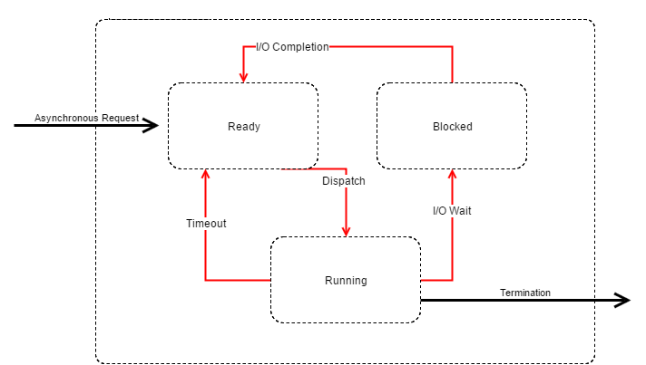
Event Driven Model
System waits in a loop for some kind of event
When the event occurs the system determines what to do
That action is taken
There are two main models for this kind of system
Used in programming and the system design
ExpressJS uses a hybrid model between Event driven and Model-View Controller

Slide 22
Event Driven Model

Slide 23
Modular Development
Code is broken up into modules
Concerns are broken up into modular parts
Written separately and shared across the project or the net
Can have independent development teams
Code reuse is very strong
There are some downsides
Lack of testing – its harder
Inconsistent programming
Dependent on potentially unknown software and developers
https://en.wikipedia.org/wiki/Modular_programming

Slide 24
Express JS
npm install –g express
express –ejs
Should generate a blank express project
Some tutorials:
http://nodeschool.io/
https://scotch.io/tutorials/use-ejs-to-template-your-node-application
http://www.danielgynn.com/build-an-authentication-app-using-express-node-passport/

Slide 25
The Course Project
For this project, you will be building a simple web interface which can scan selected folders for media and store that information in a database
This week build a simple NodeJS application which is able to use the console input library used with tictactoe “readline-sync”, to get a specific folder name.
The program must then print the files in that folder to the console.
Some Links
https://www.npmjs.com/package/readline-sync
http://stackoverflow.com/questions/2727167/getting-all-filenames-in-a-directory-with-node-js

Slide 26
The Course Project
Next session we will cover how to build tests which we will incorporate into our program
Make sure to make the program modular
We will add a database next session
We will build an interface at the end of the course
Go to http://nodeschool.io/
Go over core tutorials for node and git
Expressworks
learnyoumongo

Slide 27
So Long and Thanks For All The Fish!
And Free stuff for students (Just remember to add your student emails to your accounts on each site)
Jetbrains https://www.jetbrains.com/student/
GitHub https://education.github.com/discount_requests/new
You can find me at: https://jasonchalom.com
Email me at: contact@jasonchalom.com
Have the subject line: SoftDev2016 “what your subject is”

